Slide 1

Object Orientated Software Engineering
9.3 The Decorator Pattern
By Stephen Lindsay

Slide 2
Outline
The Coffee Shop Problem
The Qualities of the Decorator Pattern
Decorator Patterns in the Java SDK or “Ohhhh, that’s why it works like that!”
Decorator’s shortcomings

Slide 3

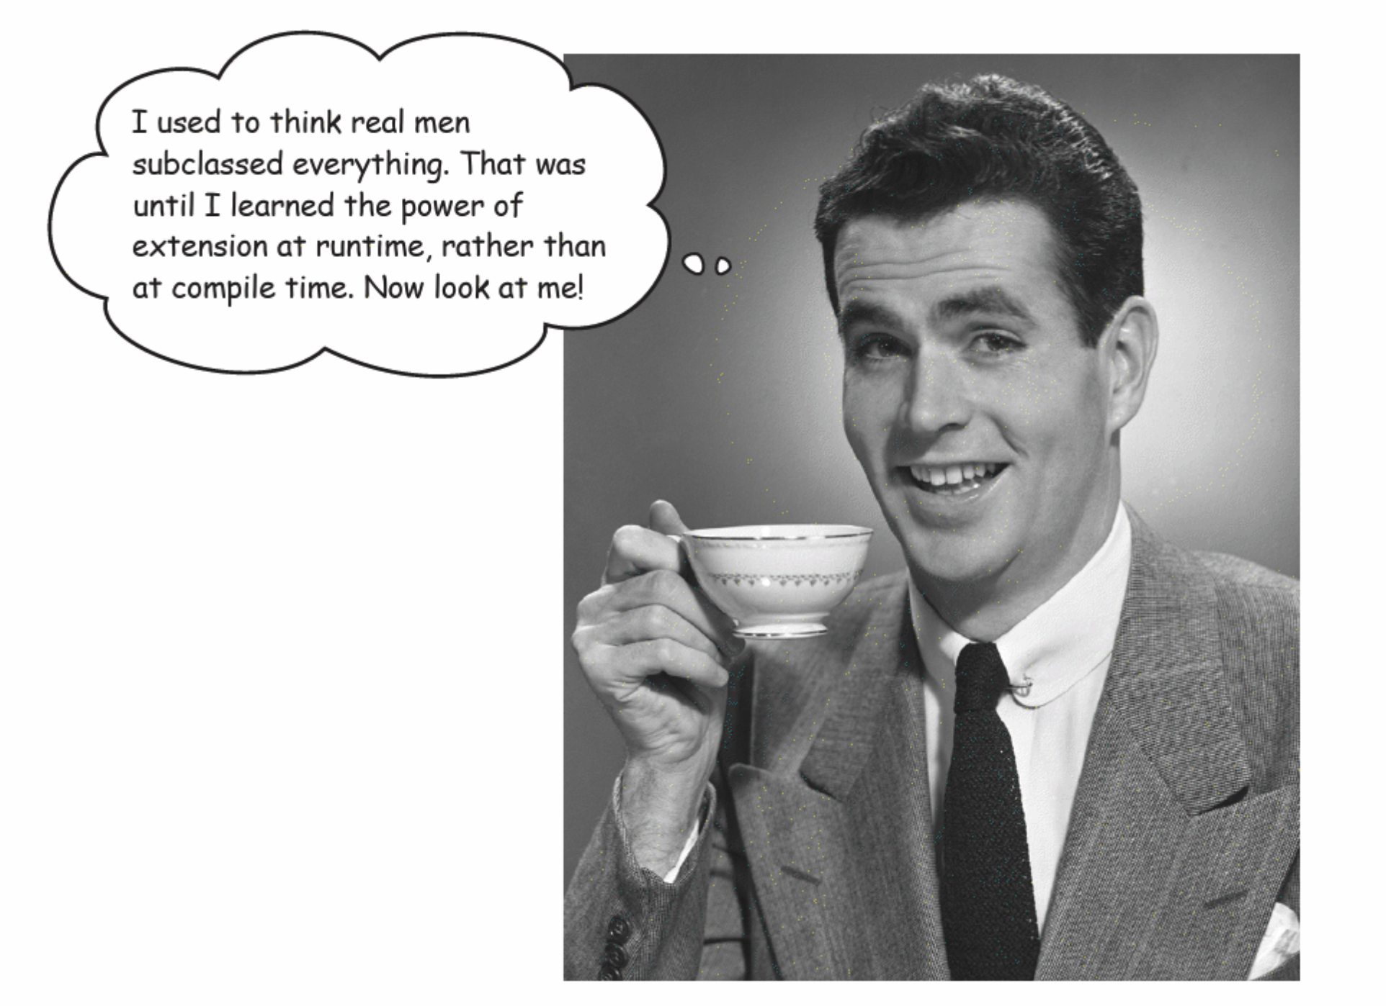
Image taken from Head First Design Patterns, Title Page and C3

Slide 4
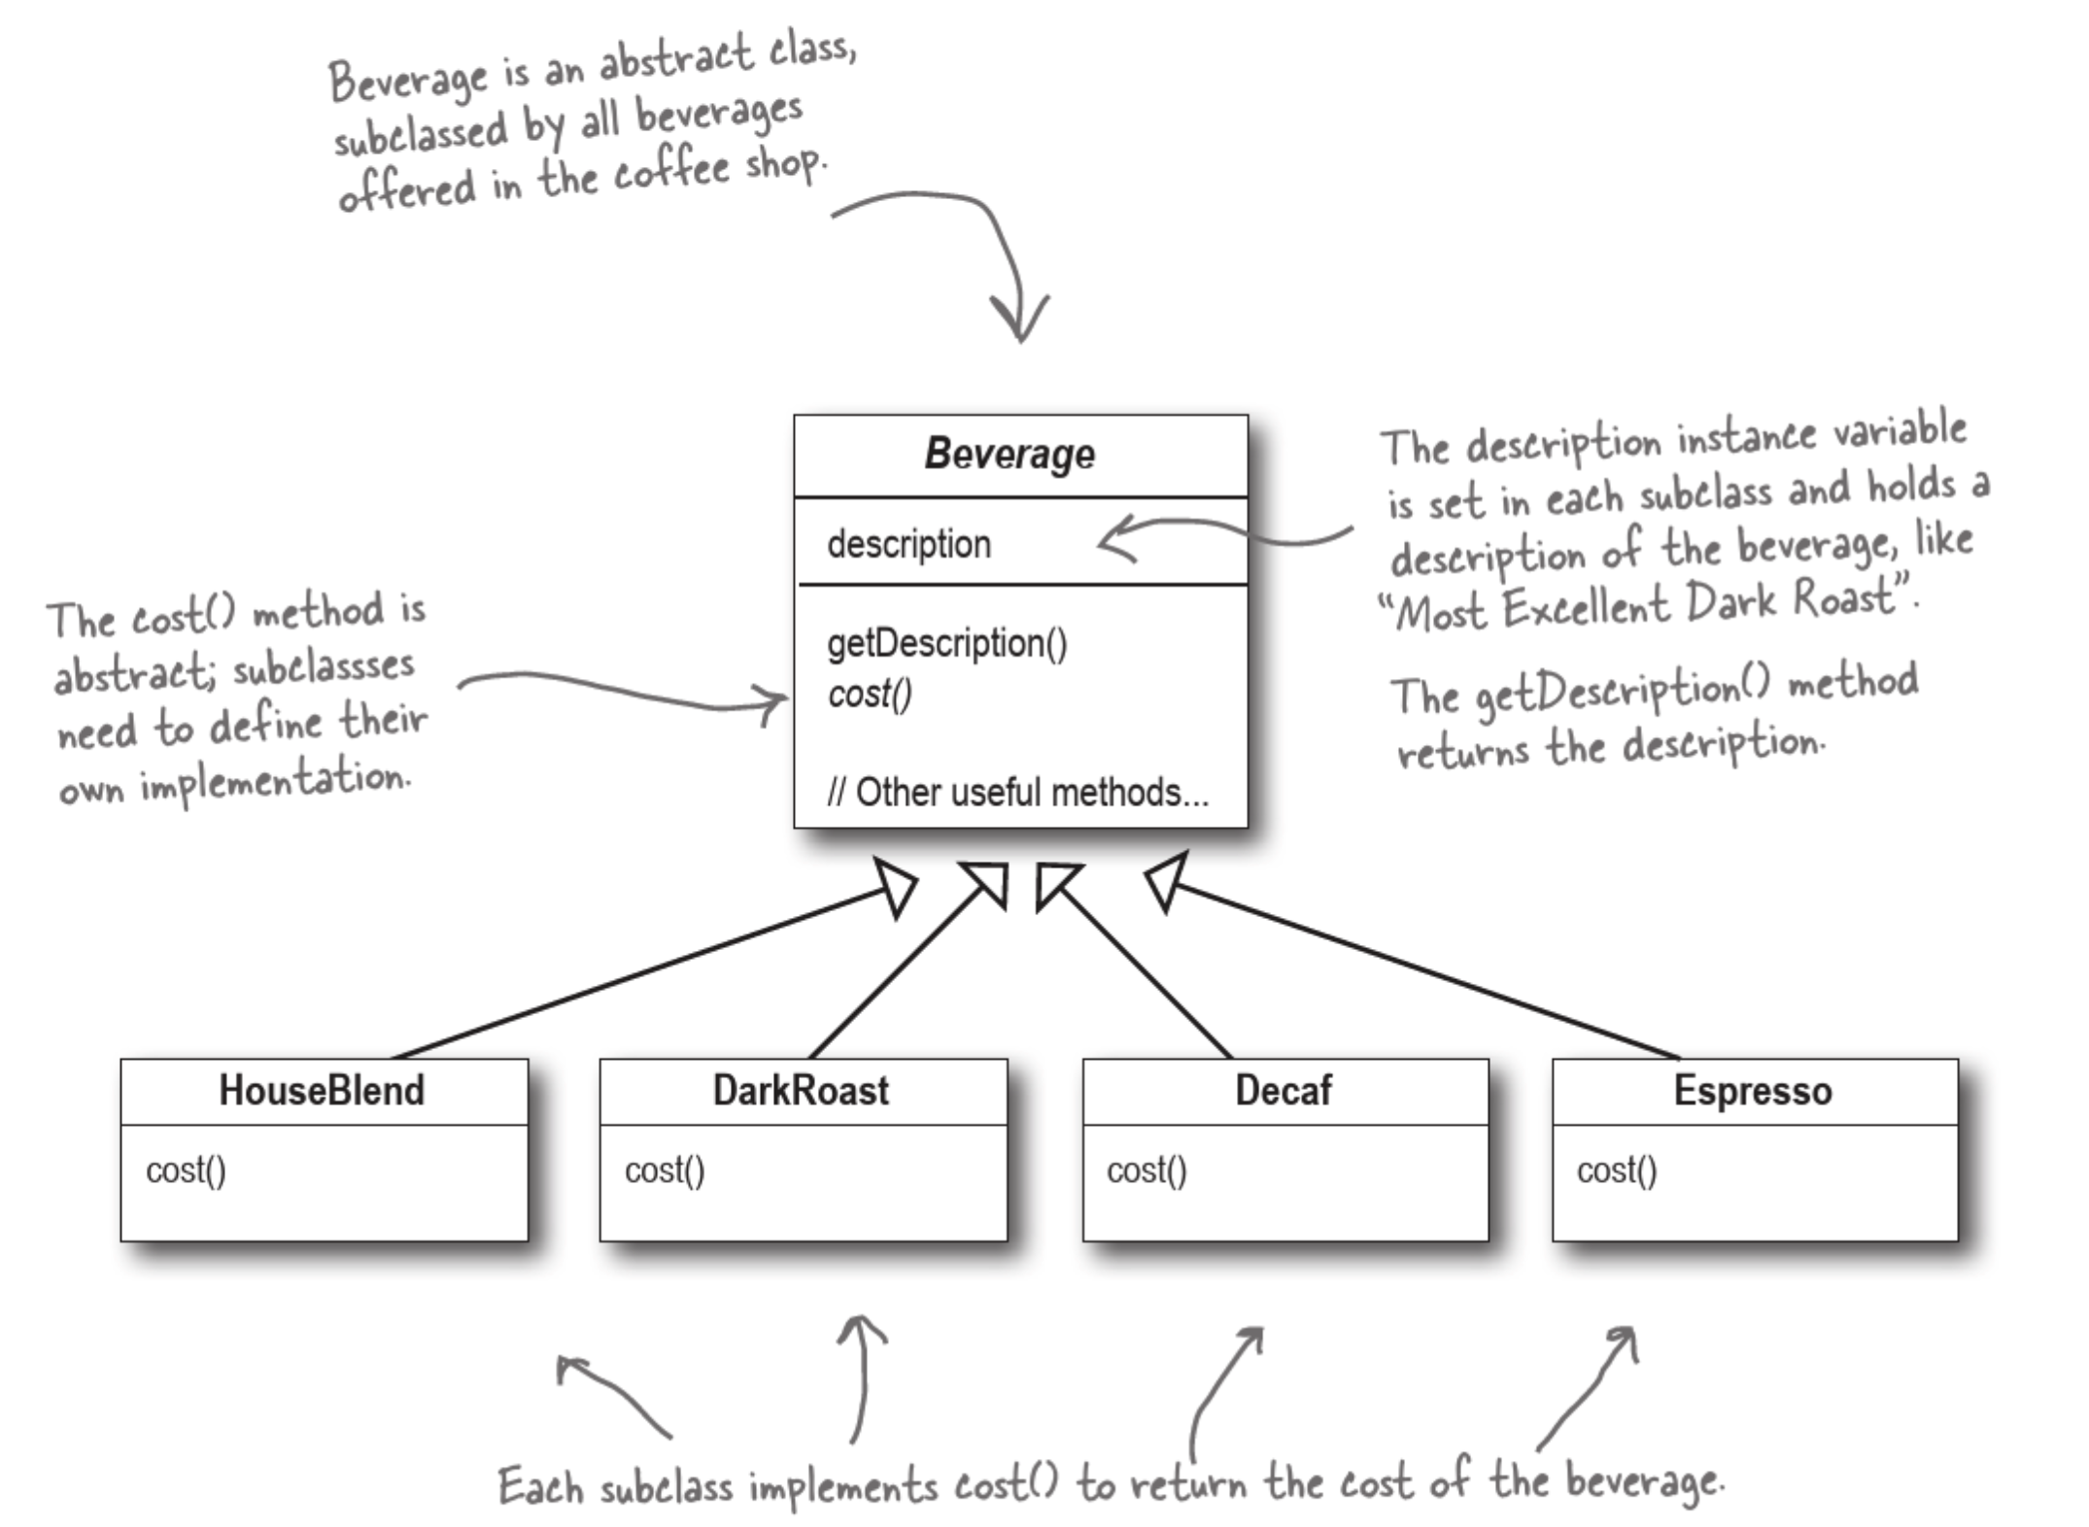
Image taken from Head First Design Patterns, C3

Slide 5
The Coffee Shop Problem
You’re handling the ordering software for a Coffee Shop chain
Your first attempt at handling the system creates a superclass called Beverage that stores string describing the drink, a getDescription method (Good encapsulation!) and a method to calculate the cost of the drink
You subclass it with the various types of coffee that people can order
So far so good, now all you need to do is handle the different variations that come with milk, steamed milk, soy milk, mocha and soy…..

Slide 6
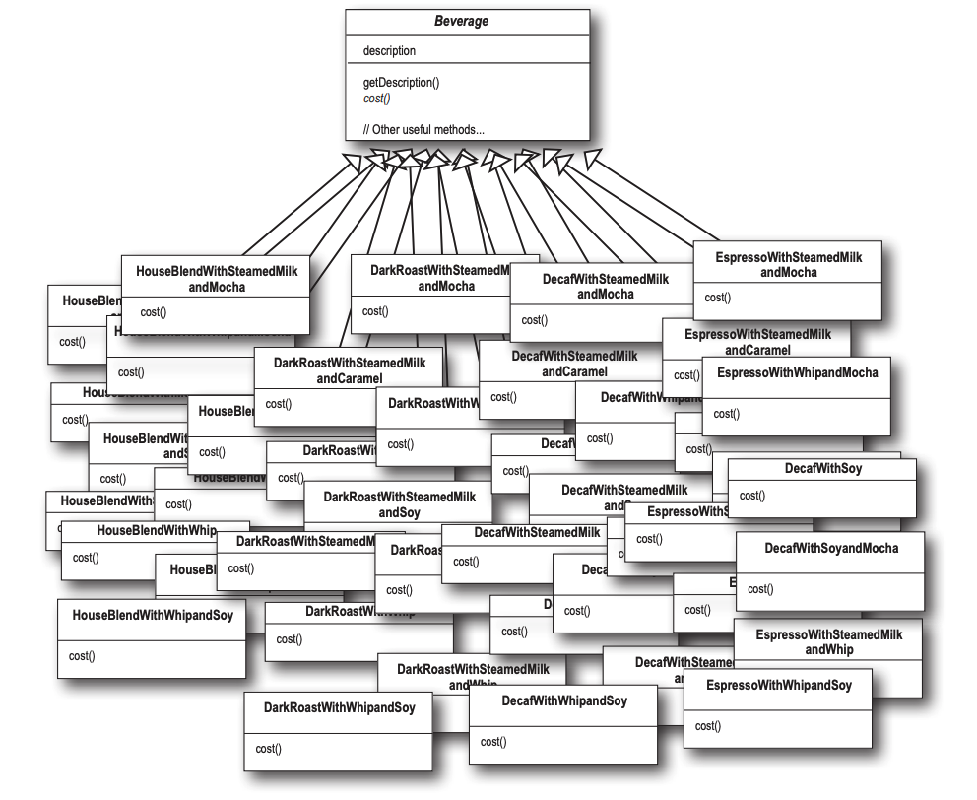
Image taken from
Head First Design Patterns, C3

Slide 7
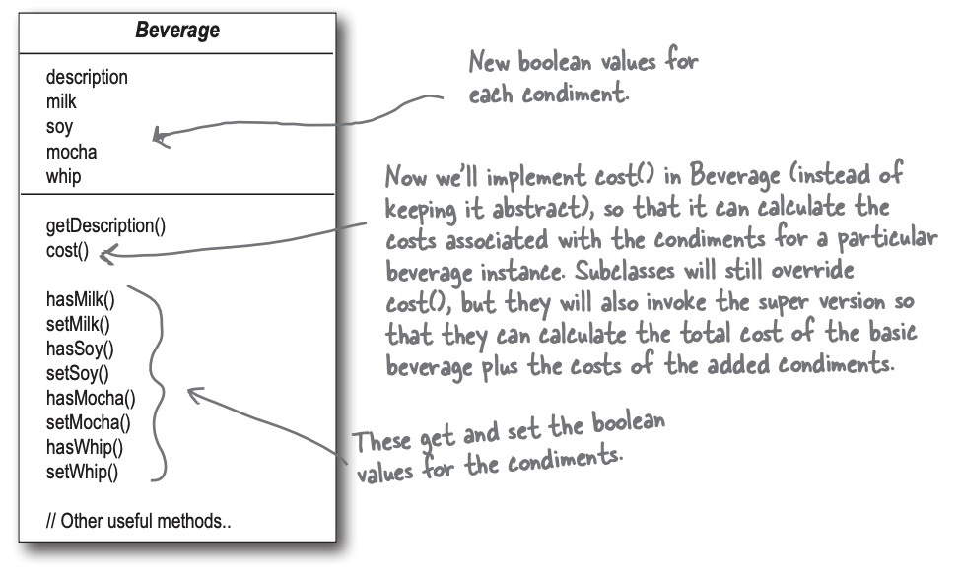
OK, but what about instance variables?
Image taken from
Head First Design Patterns, C3

Slide 8
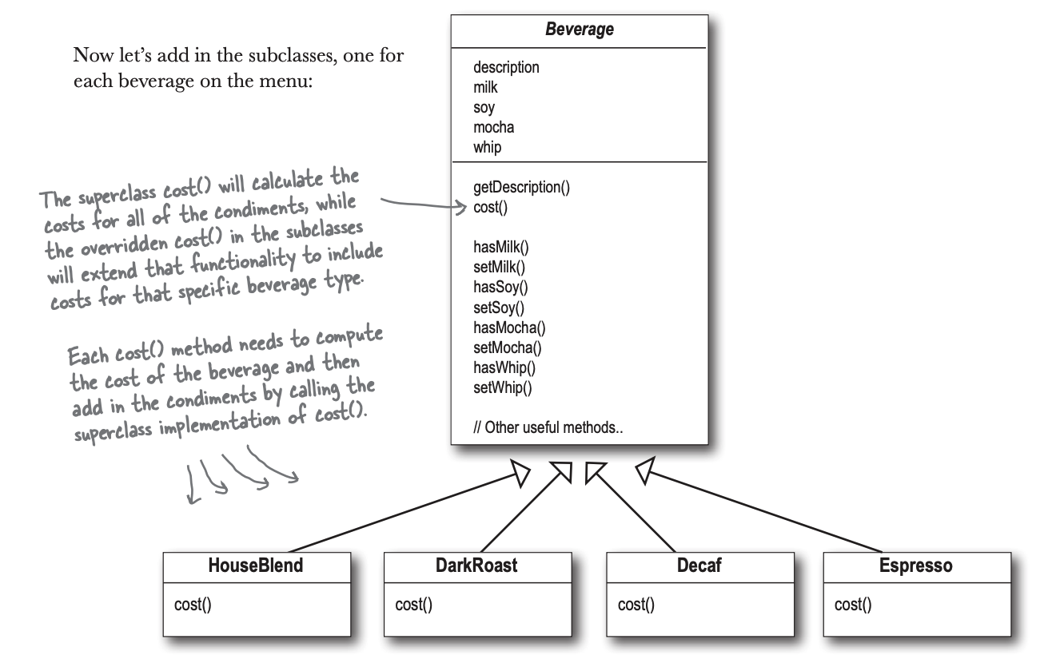
Does this look OK?
Image taken from
Head First Design Patterns, C3

Slide 9
How many problems can we spot with the idea of using instance variables to track condiments?

Slide 10
Instance variable issues
How do we alter condiment price?
How do we add new condiments?
What happens if we add a new drink and have inappropriate condiments?
How would you make a double mocha?

Slide 11
The Decorator Pattern
The Decorator Pattern attaches additional responsibilities to an object dynamically. Decorators provide a flexible alternative to subclassing for extended functionality
Look to apply decorators when a function might need to be built upon and built upon. Imagine:
A video game where the character gains more and more movement abilities and power ups as they play (jump, double jump, jump higher, etc.)
A messaging system that might need to progressively build more checks in depending on the context it’s used in (message, authorise user, authorise receiver, log messages)
Notes:
Note that it is all the same function, but it needs to do more and more in the different contexts

Slide 12
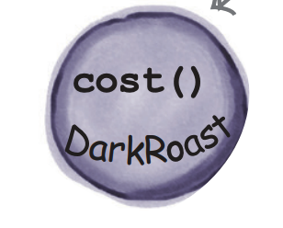
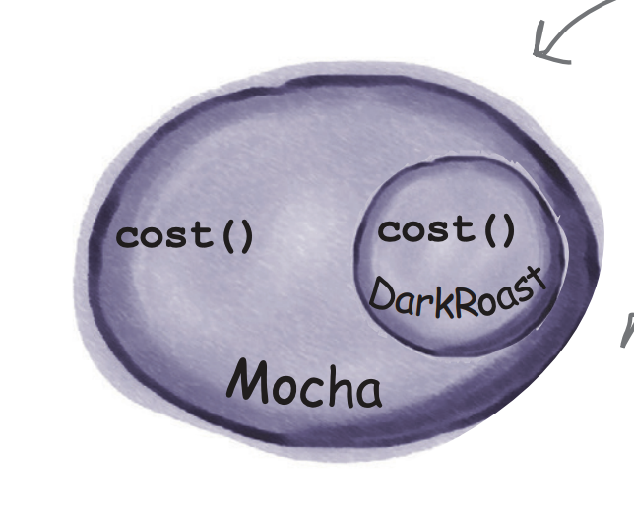
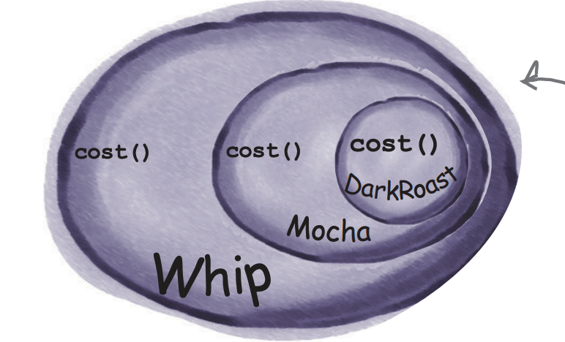
Image taken from
Head First Design Patterns, C3

Slide 13
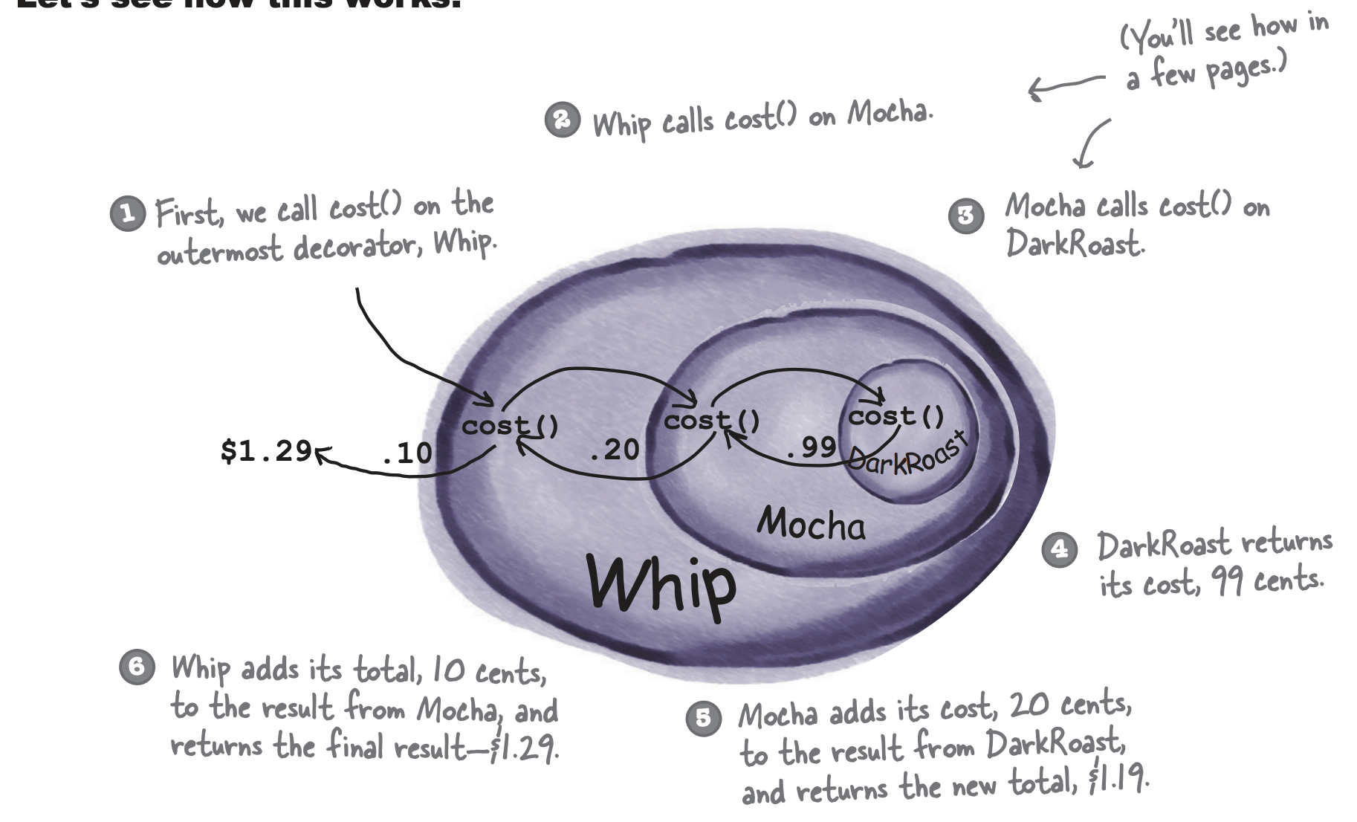

Slide 14
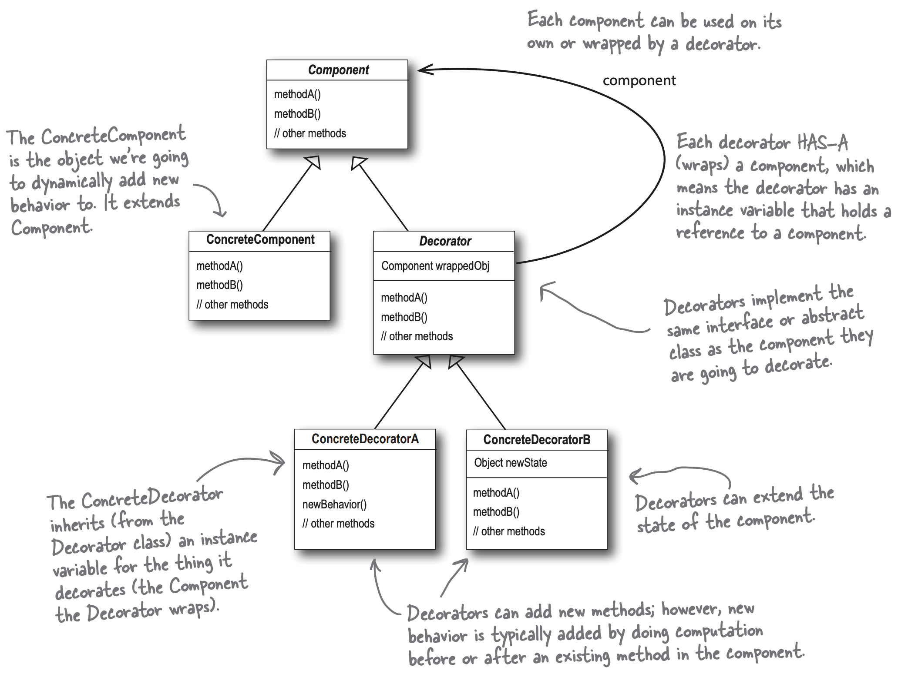
Image taken from
Head First Design Patterns, C3

Slide 15
Decorators Parts
Component – our abstract, generalisable base case
Concrete Components – specific implementations of our class
Decorator – an abstract class that implements the same interface as our component and stores a Component object
ConcreteDecorators – instances of

Slide 16
We go from this…
Image taken from
Head First Design Patterns, C3

Slide 17
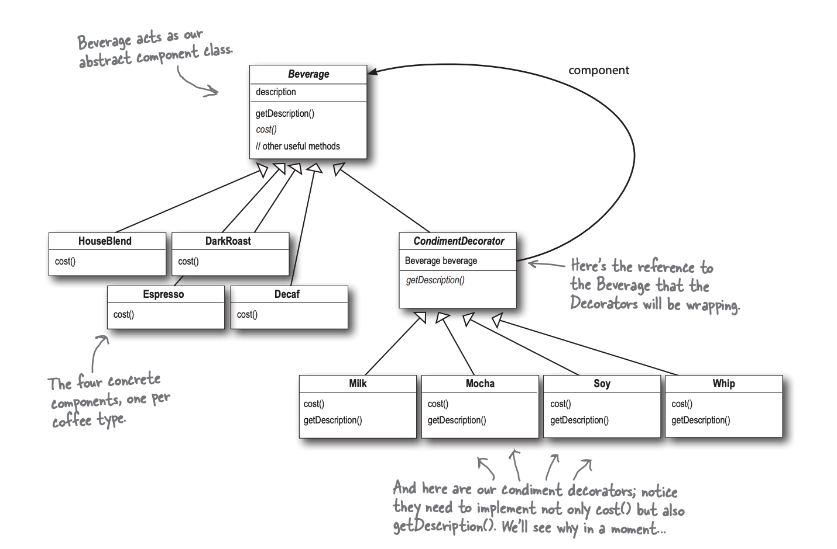
To this…
Image taken from
Head First Design Patterns, C3

Slide 18
Decorator in Java.io
As mentioned previously, one drawback of design patterns can be that, if you don’t know the pattern, designs look deeply un-intuitive:
FileInputStream fis = new FileInputStream(fileName);
BufferedInputStream bis = new BufferedInputStream(fis); ZipInputStream zis = new ZipInputStream(bis));
You might have fought with this one before – what was actually going on here?

Slide 19
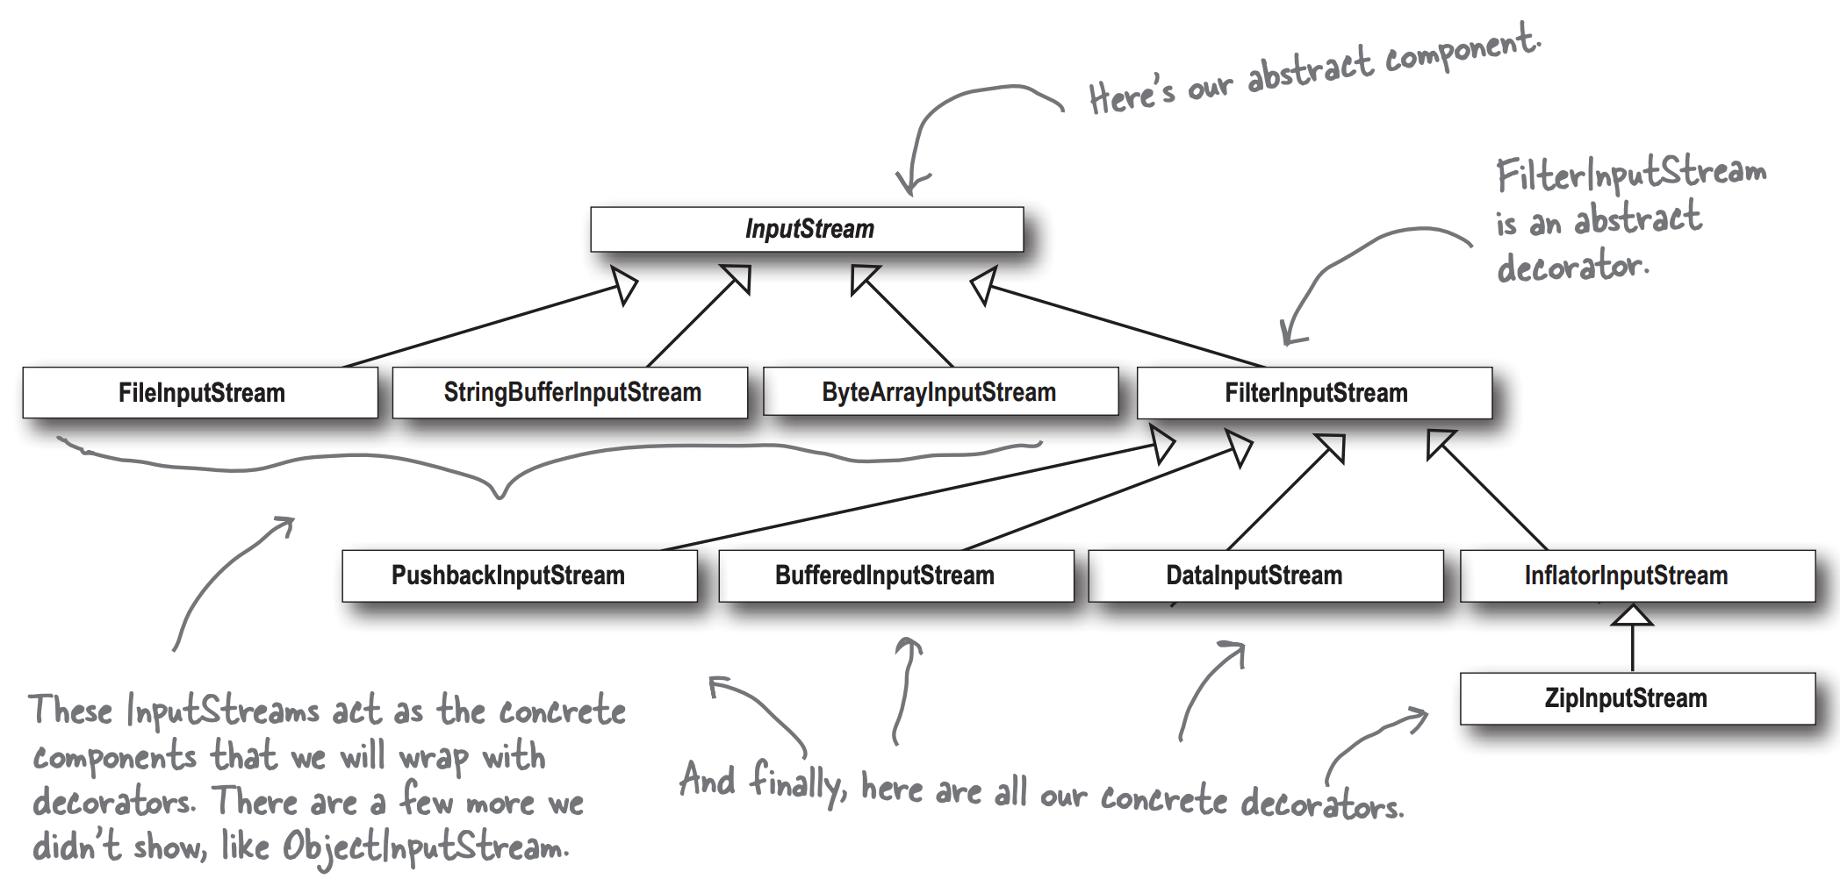
To this…
Image taken from
Head First Design Patterns, C3

Slide 20
Decorator’s Shortcomings
Imagine you are building a video game and you use decorator to build functionality onto the players weapons - you might add gems to a sword that stack fire, lighting, rock, and water damage on it
If you want those behaviours to be cumulative, so a fire effect and a lightning effect play on top of the swing and add to the damage done, that’s no issue
But what if you wanted fire and water to cancel each other out? This is where decorator might start to fall flat
Decorator patterns can be made to work with an awareness of the other decorators in their stack but it’s not their purpose
Imagine you were adding to a Damage object in this pattern – each decorators getDamage model retrieves the Damage model and adds in it’s own damage and a final applyDamage method works out which elements cancel out

Slide 21
Class Explosion and Complexity
Small class explosions – following decorator sometimes means you add a lot of small classes to a design making it hard for some people to parse (like the Java.io example!)
Instantiation complexity – creating a decorated class means quite a few lines of code (until you learn about factory and builder patterns at least!)
Typing problems – if you have code that relies on a certain type then decorator breaks it – for example, if you have this code:
if (beverage1 instanceof DarkRoast){<discount>}
Decorator will break it – the fix here is to code to the abstract Beverage class though

Slide 22
Typing Problems
Imagine that you have code that relies on a certain type then decorator breaks it – for example, if you have this code:
if (beverage1 instanceof DarkRoast){
<apply_some_discount>
}
Decorator will break it as soon as you add a decorator/wrapper
The fix here is to go back to good design principles – program to interfaces and not to implementations
If you want to be able to apply discounts that needs to be part of the abstract Beverage class and not captured in knowledge of concrete implementation
The benefit of doing it this way is that other people will be able to use your code to apply discounts when new drinks are added to the system!

Slide 23
Decorator or Strategy Pattern?
The Decorator and Strategy Pattern might appear quite similar at first glance – after all, they both add functionality in real time right?
Strategy – allows you to adjust functionality by recognising groups of behaviours
Decorator – allows you to build up a specific type of functionality
If you can remember our Ducks example, we have one fly method that does different things depending on the duck and altered by the game world
For example when a Duck get’s injured calling it’s fly method goes from calling flyRealFast becomes flyInjured
Decorator might build on top of a behaviour, so we would add the injured behaviour on top of the fly injured, allowing us to compose more complex behaviours at the cost of more complex class structure

Slide 24
Outline
The Coffee Shop Problem
The Qualities of the Decorator Pattern
Decorator Patterns in the Java SDK or “Ohhhh, that’s why it works like that!”
Decorator’s Shortcomings

